Slide 1
Logic
For CS 131- Spring 2022
By James Odanga

Slide 2
Where did Logic Come from?
One early figure who had pioneered the study of logic was a famous philosopher named Aristotle.
Aristotle throughout his time in 384-322 BCE had introduced two important concepts in propositional logic, which are Law of Excluded middle and Law of contradiction.
The law of Excluded middle relates that everything is either true or false
The Law of contradiction states that nothing is both true or false which is the cornerstone of propositional logic

Slide 3
Ways of showing Logic
Truth tables
Boolean Expressions.
As well as Gates

Slide 4
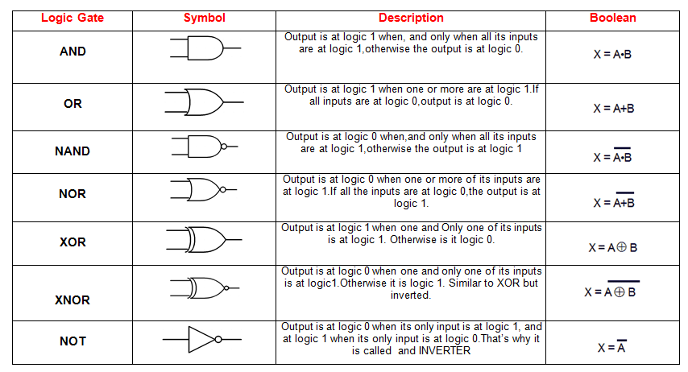
Brief overview of Logic and Gates.

Slide 5
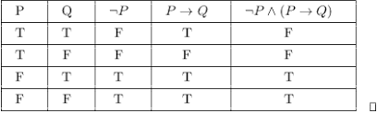
Propositional logic in truth tables

Slide 6
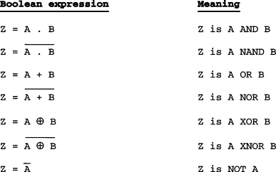
Boolean Expressions

